Slide 1
Object Detection with Single Shot MultiBox Detector
Hongkyung Kim, Gunhee Lee, JungGyu Hwang

Slide 2
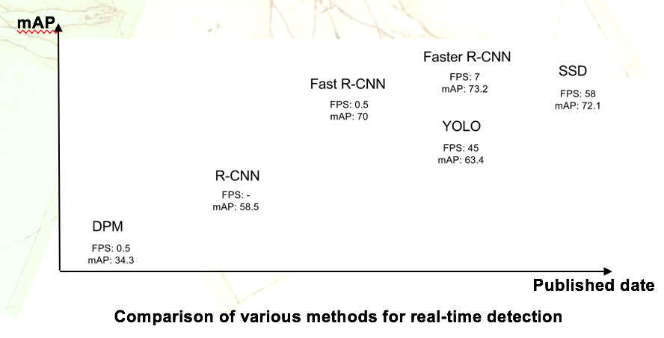
Introduction
Goal
Understand deep learning-based object detection algorithms
Study five recent papers related to object detection
Study five recent papers related to techniques for detecting small object, which is the major cause of dropping detection accuracy
Implement Single Shot multibox Detector (SSD) algorithm with techniques for detecting small object
Motivation
Small object is not detected well, despite the great improvement of object detection with deep learning
Speed is as important as accuracy for real-time detection

Slide 3
Survey on Related Works
Object detection algorithms
Title | mAP | FPS | Method
Faster R-CNN | 76.4 | 5 | Use Region Proposal Network (RPN) that shares full-image convolutional features with the detection network.
R-FCN | 76.6 | 5 | Fully convolutional with almost all computation shared on the entire image. position-sensitive score maps.
You Only Look Once: Unified, Real-Time Object Detection | 63.4 | 45 | YOLO runs a single convolutional network on the image, and thresholds the resulting detections by the model’s confidence
SSD: Single Shot MultiBox Detector | 74.3 | 46 | SSD uses multi-scale convolutional bounding box outputs attached to multiple feature maps at the top of the network.
YOLO9000: Better, Faster, Stronger | 76.8 | 67 | YOLOv2 model can run at varying sizes, offering an easy tradeoff between speed and accuracy. YOLO9000 use WordTree to combine data from various sources and our joint optimization technique

Slide 4
Survey on Related Works (cont.)
Techniques for detecting small object
Title | Hour-glass | Multi-scale feature based detection | Image Pyramid | RoI Align | Method | Base Network
Feature Pyramid Networks for Object Detection | O | O | X | X | Feature pyramid is used instead of one feature map for object proposal detection and classification & regression process in Faster R-CNN | ResNet101
Finding Tiny Faces | X | O | O | X | Resize images at test-time by interpolation and decimation. | Inception ResNet
Beyond Skip connections: Top-Down Modulation for Object Detection | O | X | X | X | Top-down modulation is proposed to construct the back of the network by combining high-level and low-level features with skip connections | ResNet
DSSD: Deconvolutional Single Shot Detector | O | O | X | X | An asymmetric hourglass network structure is effectively constructed by making decoder stage extremely shallow based on SSD | ResNet
Zoom Out-and-In Network with Recursive Training for Object Proposal | O | O | X | X | A zoom-out-and-in network is proposed to utilize feature maps in different semantic levels and resolutions. Anchors are divided into clusters based on different scales and placed at feature maps with distinct strides | Inception-BN

Slide 5
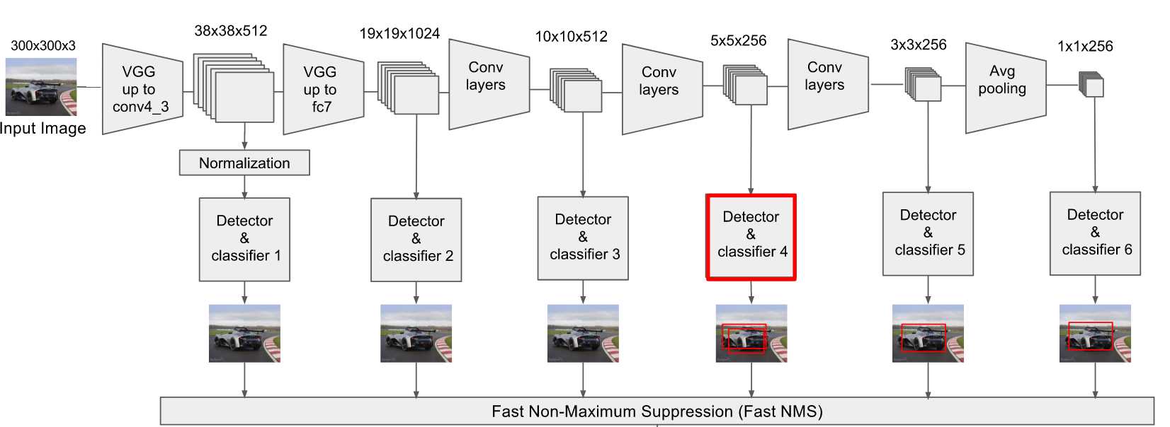

Methods
The predictions from multiple feature maps are combined
Auxiliary structure is added to the VGGNet to produce detections with the following key features
Multi-scale feature maps for detection
Convolutional predictors for detection
Default boxes and aspect ratios
Collection of bounding boxes and scores for the presence of object class instances in those boxes are produced
Non-maximum suppression step is performed for all of the detection results to derive the final results
Final detection
Pipeline of the proposed method

Slide 6
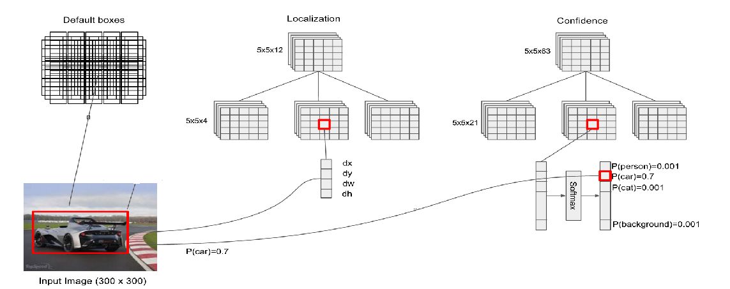
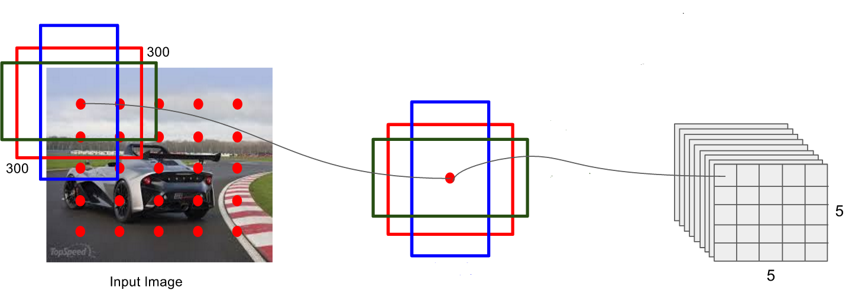
Methods (cont.)
Three default boxes of different aspect ratios are created for each cell in the feature maps
1:1, 1:2, 2:1 were selected for aspect ratio of default boxes
For each default box, the offsets relative to the default box shapes in the cell and the per-class scores that indicate the presence of a class instance are predicted
In the localization step, the center coordinates, width, and height of the default boxes are learned
In the confidence step, parameters for each class are learned
The process of creating default boxes
The process of detecting and classifying objects

Slide 7
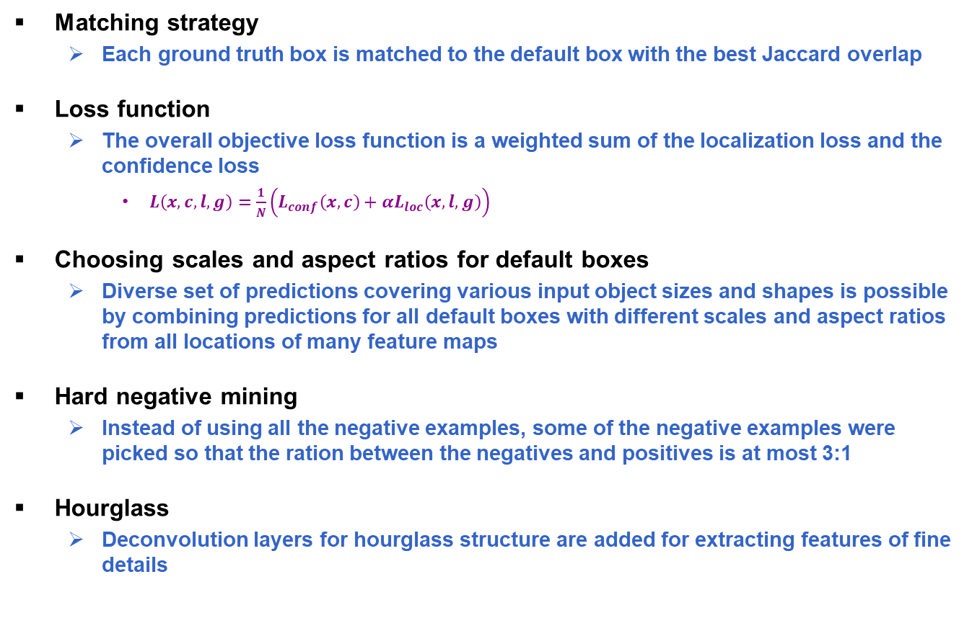
Methods (cont.)
Matching strategy
Each ground truth box is matched to the default box with the best Jaccard overlap
Loss function
The overall objective loss function is a weighted sum of the localization loss and the confidence loss
$L\left(x,c,l,g\right)=\frac{1}{N}\left(L_{conf}\left(x,c\right)+αL_{loc}\left(x,l,g\right)\right)$
Choosing scales and aspect ratios for default boxes
Diverse set of predictions covering various input object sizes and shapes is possible by combining predictions for all default boxes with different scales and aspect ratios from all locations of many feature maps
Hard negative mining
Instead of using all the negative examples, some of the negative examples were picked so that the ration between the negatives and positives is at most 3:1
Hourglass
Deconvolution layers for hourglass structure are added for extracting features of fine details

Slide 8
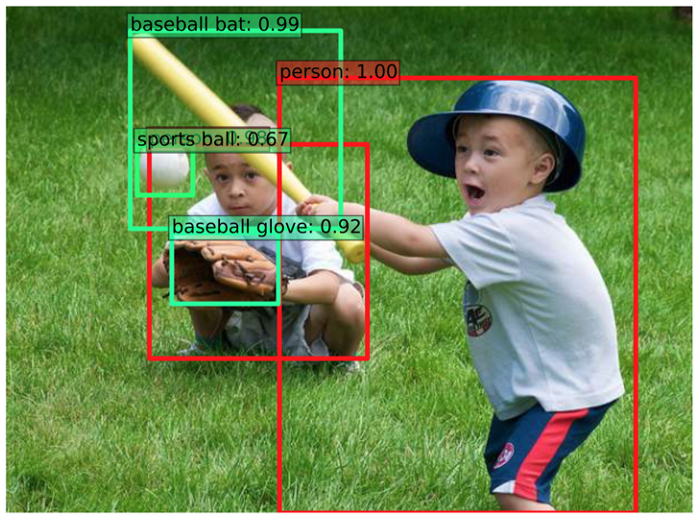
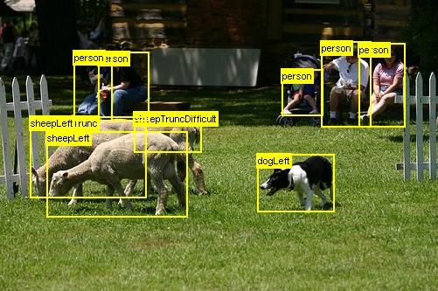

Experiments
PASCAL VOC datasets are used to evaluate object detection performance
The PASCAL Visual Object Classes contain train/validation/test: 9,963 images containing 24,640 annotated objects
Competition to detect the type of object in the input image
Small object is defined on COCO dataset
Microsoft COCO dataset contains 82,783 training and 40,504 validation images
Three types of instance size existed: small (α <${ 32}^{2})$, medium (${32}^{2}≤$α$<{96}^{2})$, and large (${96}^{2}≤$α$)$, where α is the area of the object
Detection example on COCO dataset
Detection example on PASCAL VOC 2007 dataset
Notes:
TODO: dataset 설명하기

Slide 9
Reference
References
T. Y. Lin, P. Dollar, R. Girshick, K. He, B. Hariharan, and S. Belongie, “Feature Pyramid Networks for Object Detection,” arXiv, 2016.
A. Shrivastava, R. Sukthankar, J. Malik, and A. Gupta, “Beyond Skip Connections: Top-Down Modulation for Object Detection,” arXiv, 2016.
H. Li, Y. Liu, W. Ouyang, and X. Wang, “Zoom Out-and-In Network with Recursive Training for Object Detection,” arXiv, 2017.
W. Liu, D. Anguelov, D. Erhan, C. Szegedy, S. Reed, C. Y. Fu, and A. C. Berg, “SSD: Single Shot Multibox Detector,” European Conference on Computer Vision, Amsterdam, Netherlands, October 8-16, 2016.
C. Y. Fu, W. Liu, A. Ranga, A. Tyagi, and A. C. Berg, “DSSD: Deconvolutional Single Shot Detector,” arXiv, 2017.
P. Hu and D. Ramanan, “Finding Tiny Faces,” arXiv, 2016.
J. Redmon, S. Divvala, R. Girshick, A. Farhadi, “You Only Look Once: Unified, Real-Time Object Detection,” arXiv, 2016.
J. Redmon and A. Farhadi, “YOLO9000: Better, Faster, Stronger,” arXiv, 2016.
S. Ren, K. He, R. Girshick, and J. Sun, “Faster R-CNN: Towards Real-Time Object Detection with Region Proposal Networks,” arXiv, 2015.
J. Dai, Y. Li, K. He, and J. Sun, “R-FCN: Object Detection via Region-based Fully Convolutional Networks,” arXiv, 2016.

